Slide 1

Psych 1A: How to study
Dr. Emily Nordmann (she/her)
Emily.Nordmann@glasgow.ac.uk
@emilynordmann

Slide 2
Research Methods
Lecture 1: How to study
Lecture 2: The past, present, and future of psychology
Lecture 3: Good science
Lecture 4: Bad science
Lecture 5: How psychology went from Freud to fraud
Lecture 6 – 10: Holly Scott – Applications of psychological methods

Slide 3

1st year of university

Slide 4

Intended Learning Outcomes
By the end of this lecture you should be able to :
Explain a range of effective learning strategies and how to use them
Explain what to do before, during and after lectures
Demonstrate where to get help and support
The content of this lecture will not be examined!

Slide 5
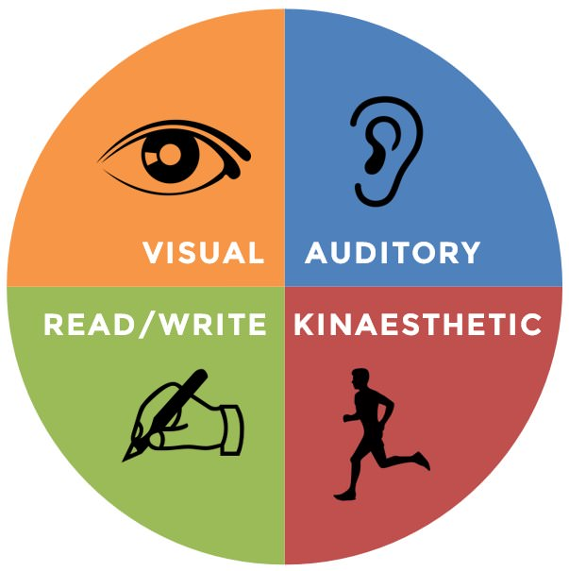
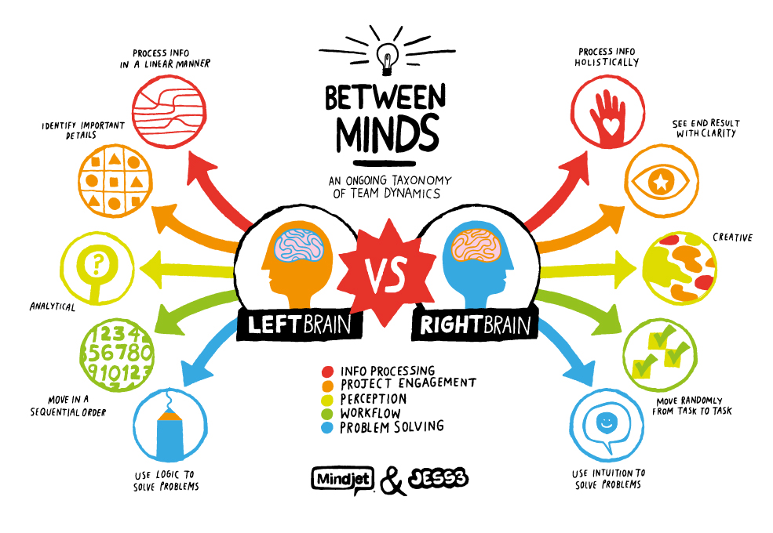
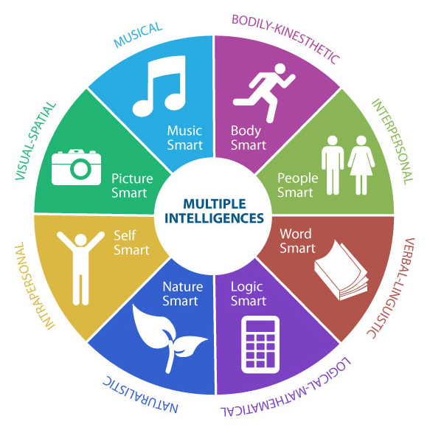
Learning styles
NO

Slide 6
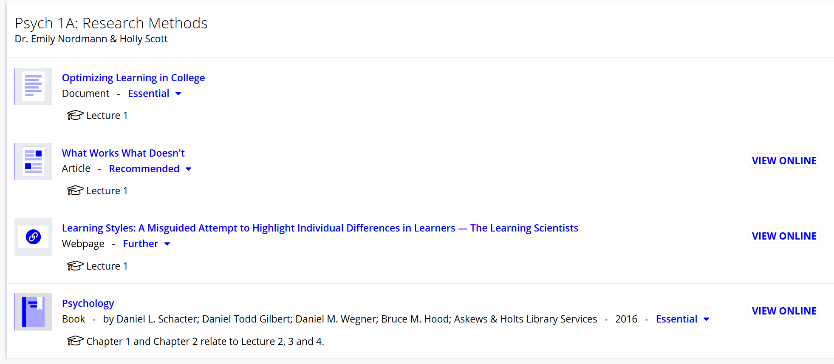
Before lectures
Download/print lecture slides and read through them
More efficient (and less effortful!) encoding during the lecture
Ensures less time taking notes that regurgitate the slides
Marsh and Sink (2010)
Do the essential reading
There may also be further or recommended reading that gives additional detail
The main course textbook is available online via the library for free

Slide 7
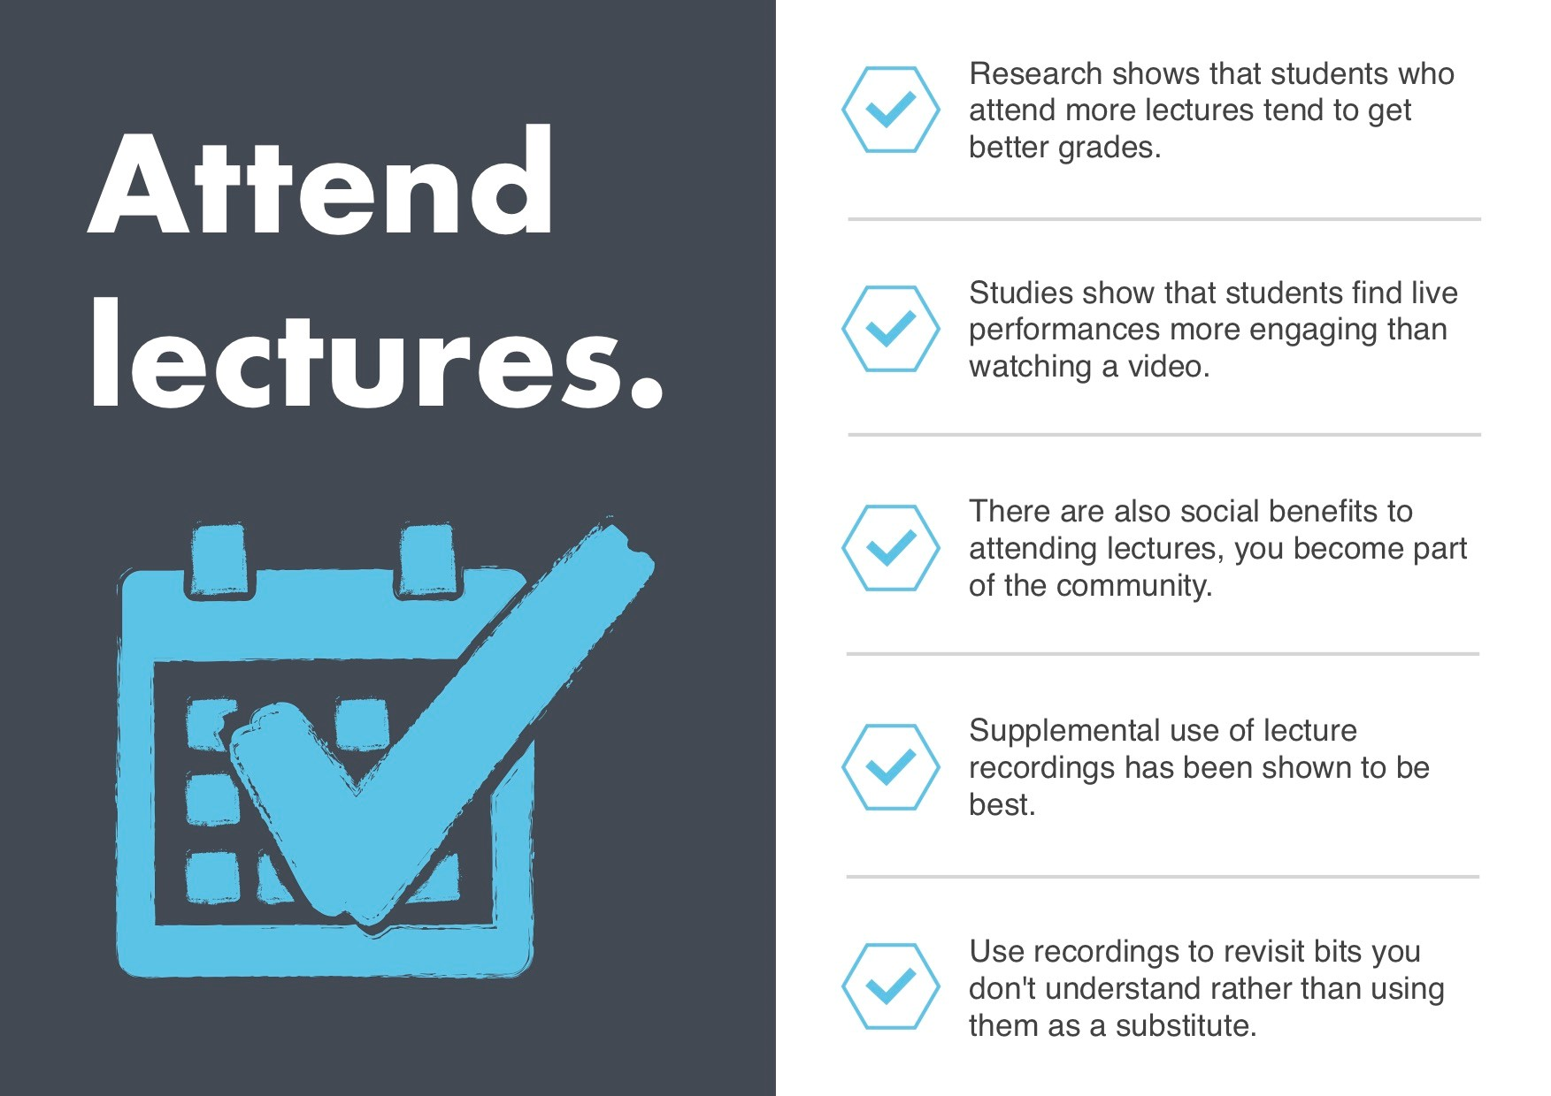
During lectures: turn up
Attendance is a stronger predictor of final course grade than high school GPA, study habits and study skills (Crede et al., 2010)
Watching lecture recordings does not make up for failing to attend the lecture
Bos et al. (2016)
Nordmann et al. (2019)

Slide 8
During lectures: turn up
There are lots of legitimate reasons to miss a lecture:
Physical and mental health problems
Timetable clashes
Caring responsibilities
Financial/commuting issues
Don’t miss lectures you don’t have to, it will mitigate the impact of the ones you can’t avoid missing
Keep a record of your attendance
There are apps you can use, e.g., Attendance Tracker for Students
Hold each other accountable & look after each other

Slide 9
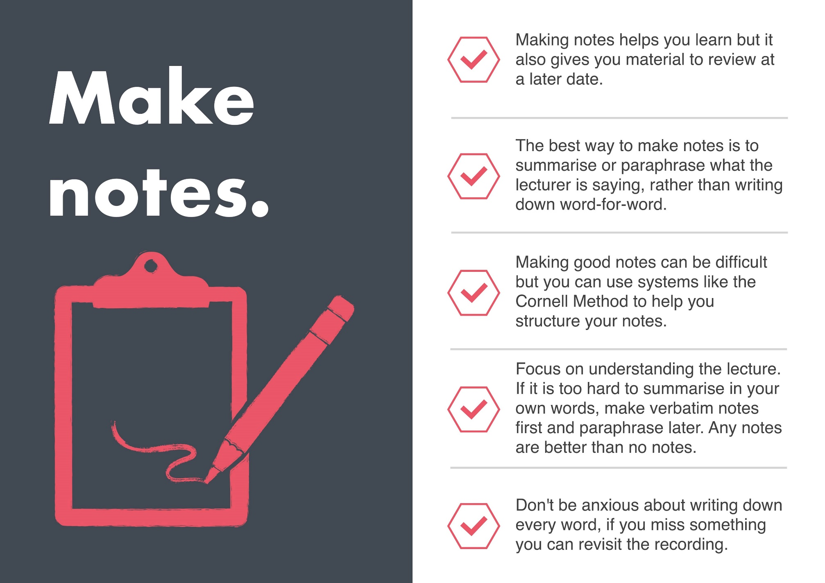
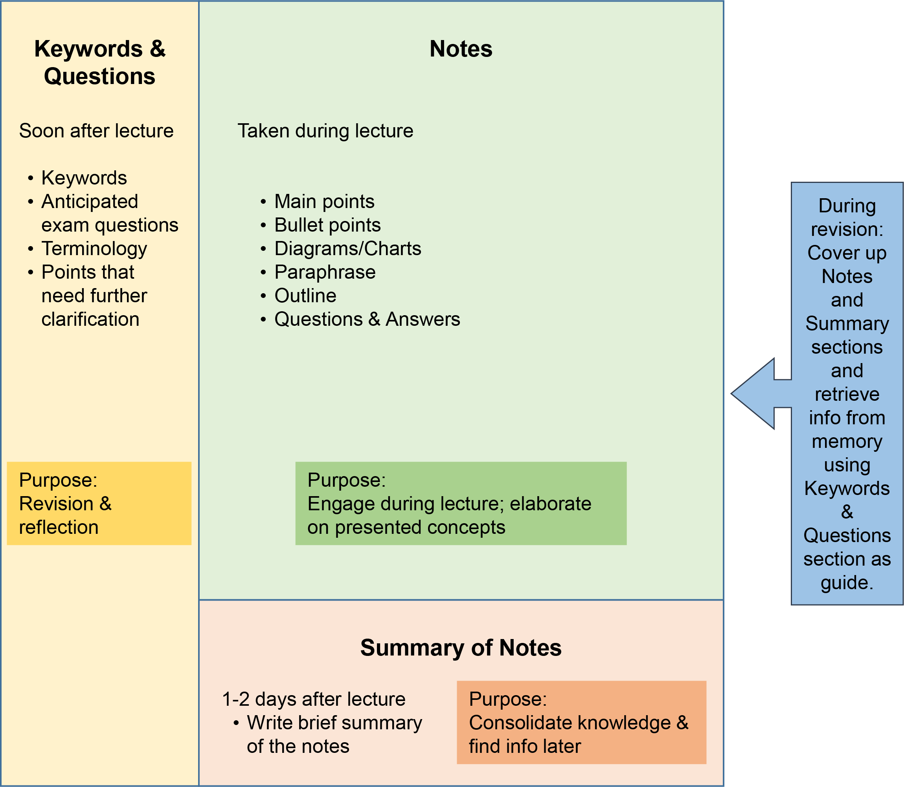
During lectures: take notes

Slide 10
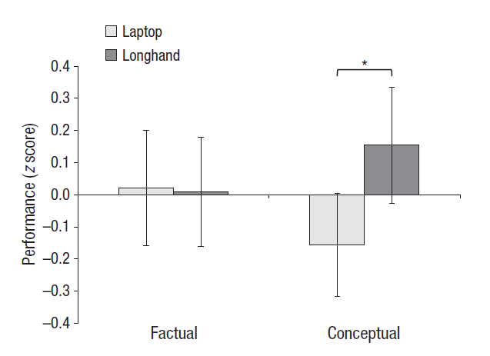
During lectures: take notes
Some evidence that taking notes by hand is better than using a laptop
Linked to deep processing and summarisation process
Mueller & Oppenheimer (2014)
But better evidence that the real problem is distraction (and not just for the person on the laptop)
Sana et al. (2011)
Patterson & Patterson (2017)

Slide 11
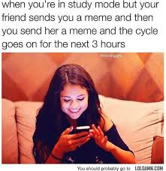
During lectures: focus
If you use a laptop consider taking handwritten notes
Install an app that blocks access to social media etc. and switch it on during lectures
You can also get one for your phone – search for Social Media Blockers (I use Cold Turkey)
Be considerate of others around you, you are not the centre of the universe

Slide 12
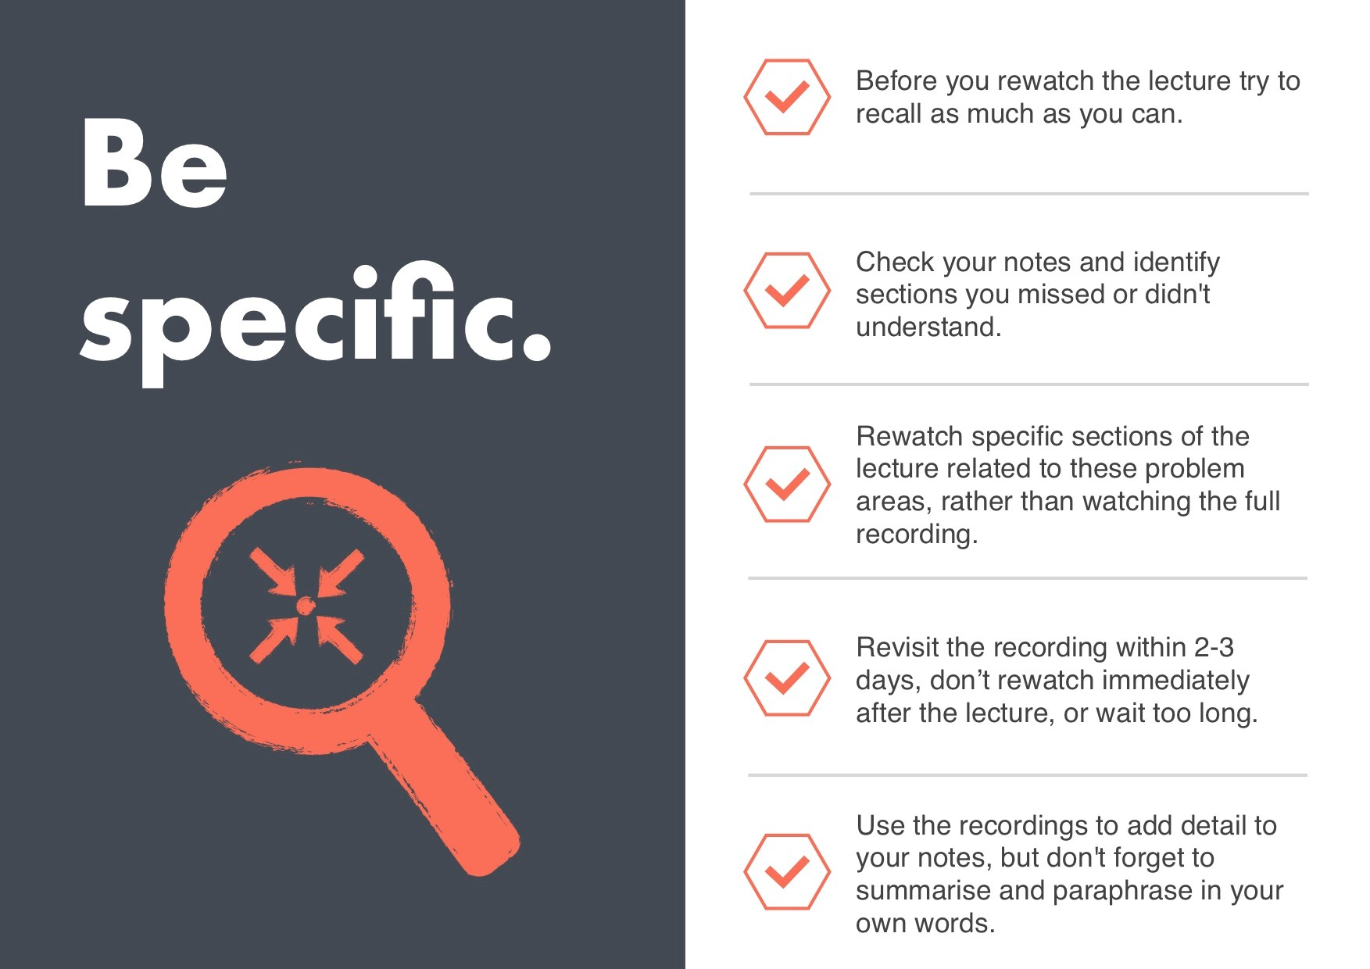
After lectures: review notes
Make sure your notes will make sense to you when you’re revising
Do any further or recommended reading and add information to your notes
Use the lecture recordings to revisit bits of the lecture you didn’t understand
Use the Cornell system to test yourself

Slide 13
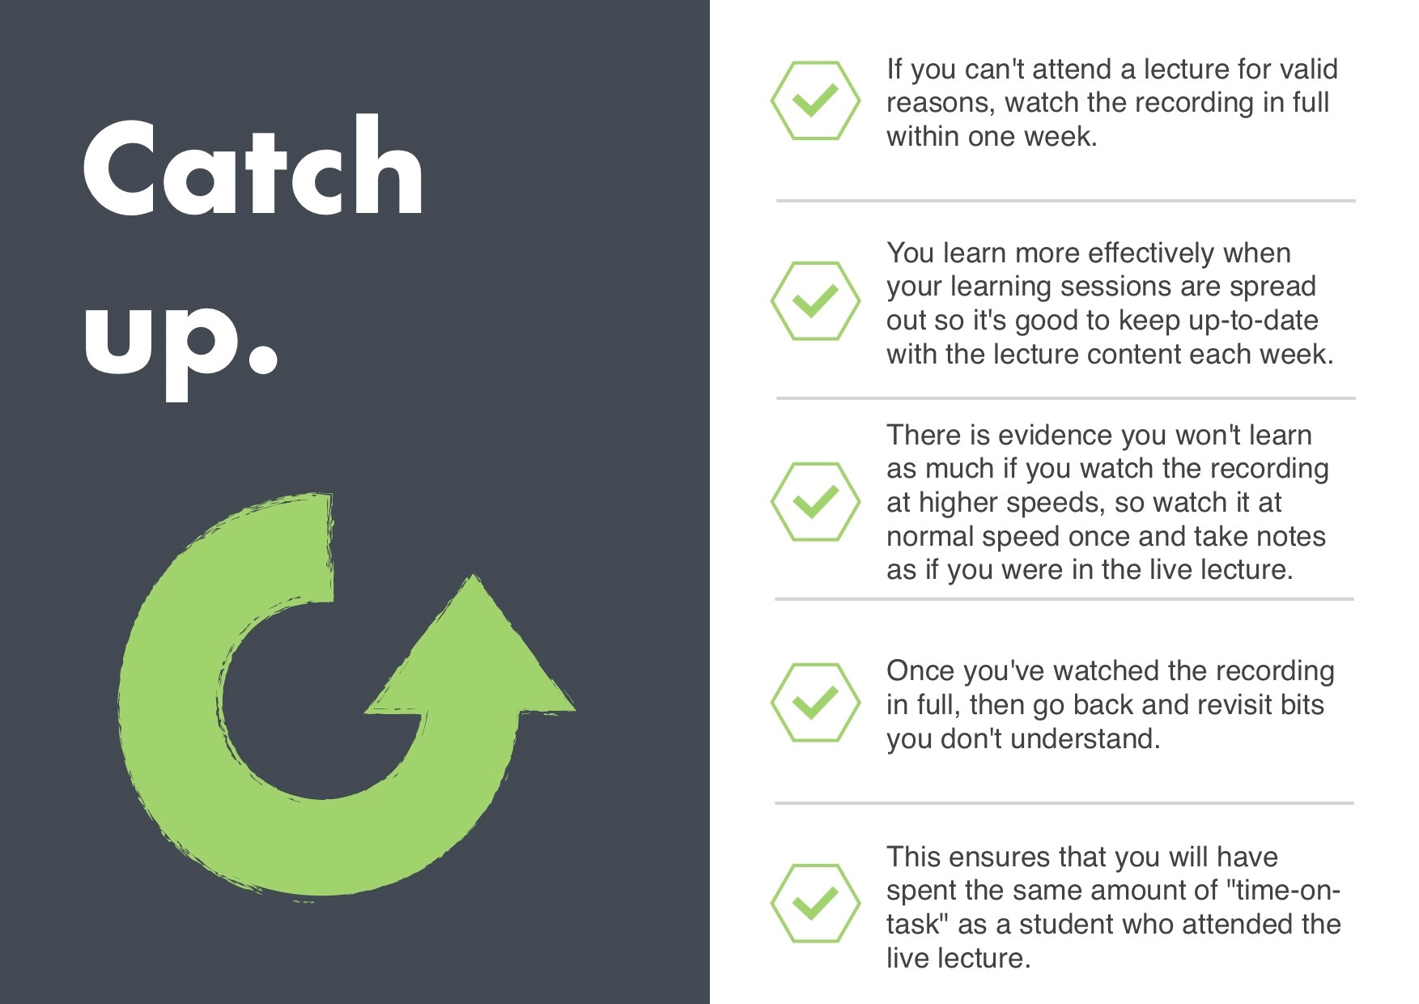
After lectures: catch-up
You can binge-watch Stranger Things, you can’t binge watch Psych 1A (and hope to learn anything).

Slide 14
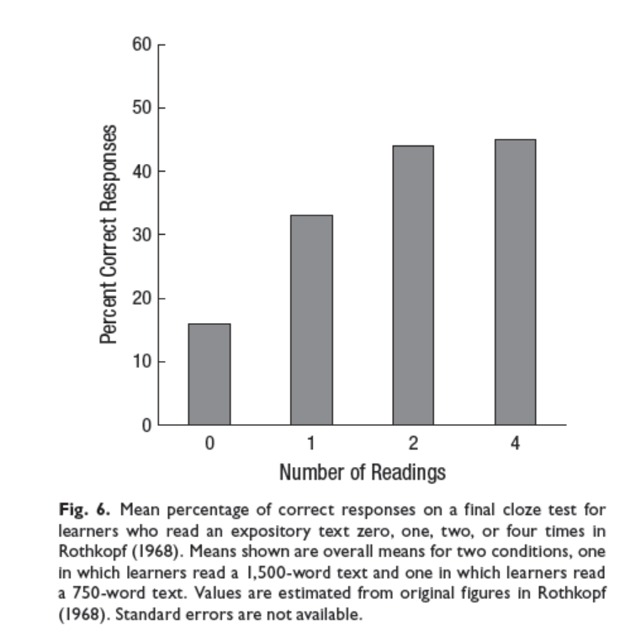
Reading vs. re-reading
Massed versus spaced reading
Spaced outperforms massed with moderate lags and delayed tests
Dunlosky et al. (2013)
Read each text once, twice if you need to revise specific sections and then do something more effective

Slide 15


Highlighting & underlining
Inverse relationship between amount of text highlighted and performance
Dunlosky et al. (2013)
Stick to the M&M rule: highlight meaningfully and minimally

Slide 16
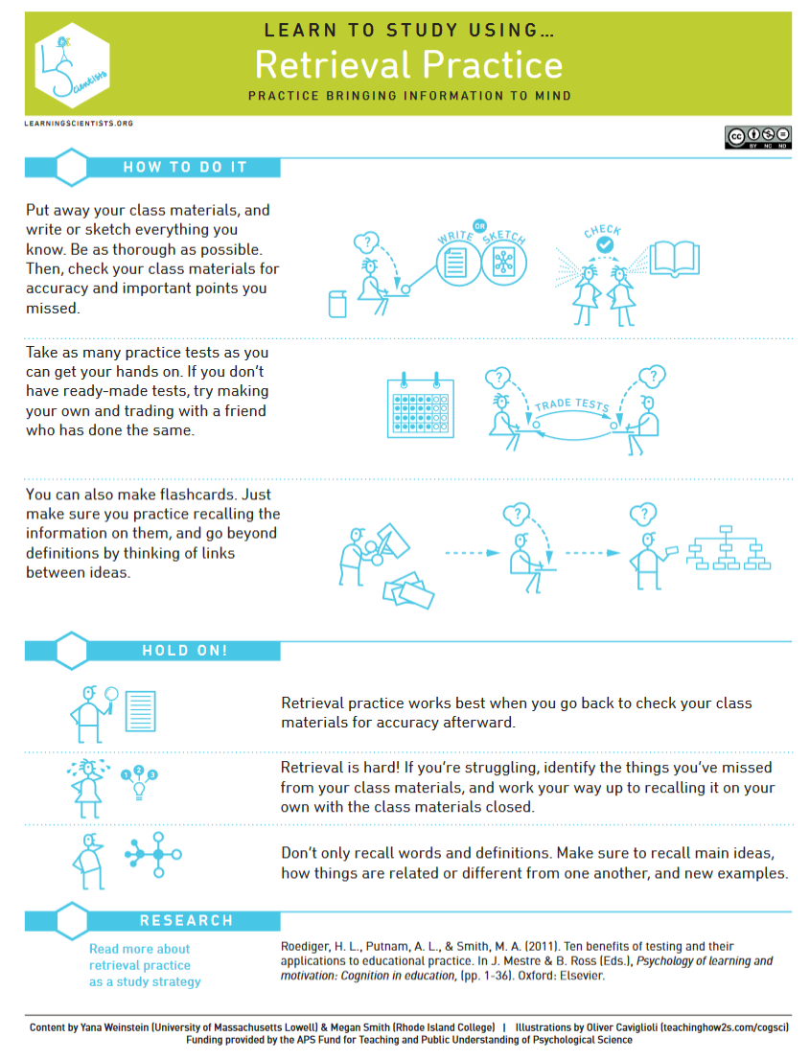
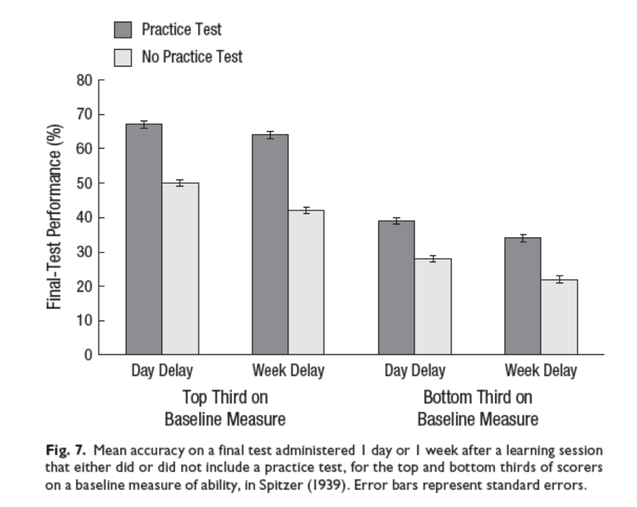
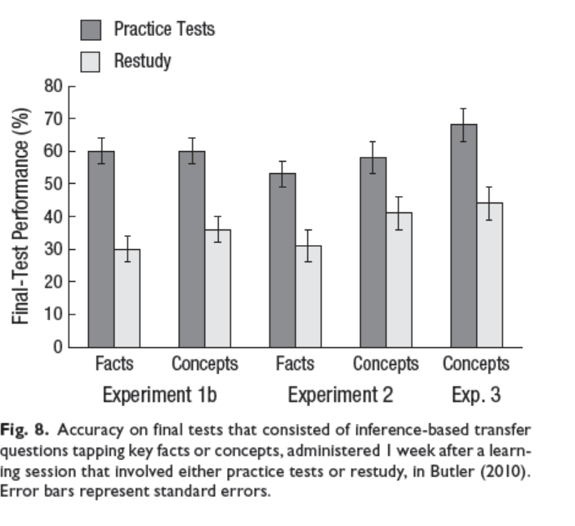
Retrieval practice
Retrieval practice = testing yourself
Dunlosky et al. (2013)

Slide 17
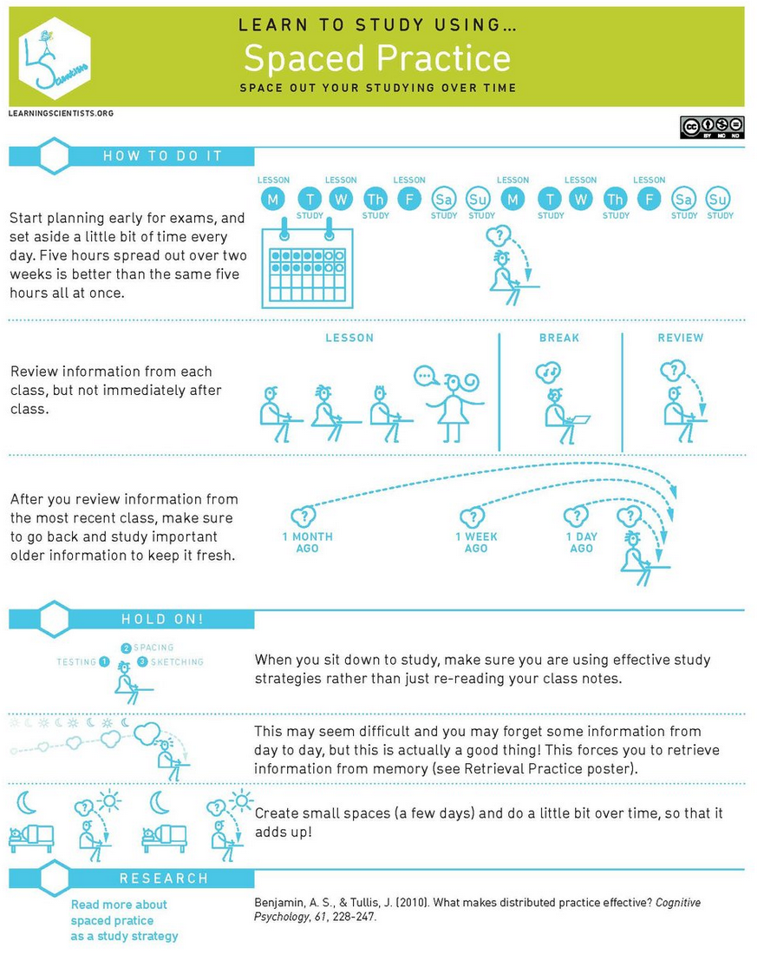
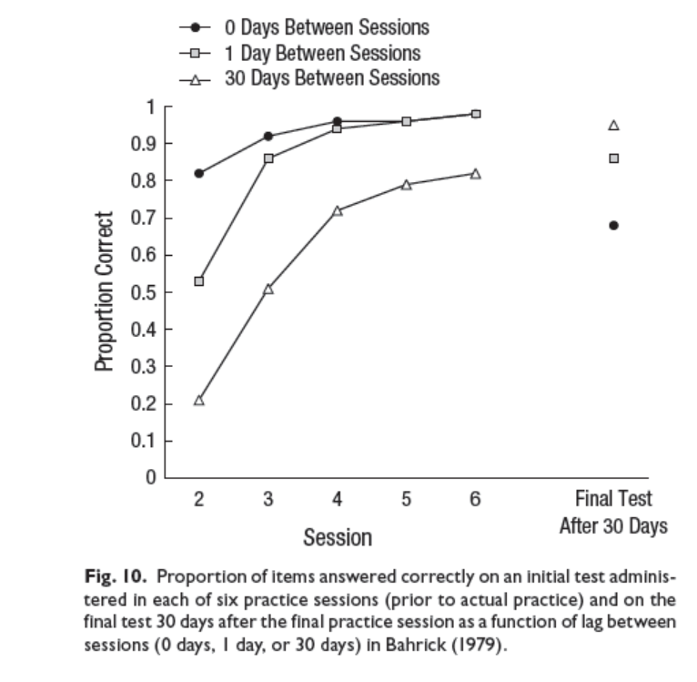
Distributed practice
Distributed practice = spread out your studying
E.g., Use lecture recordings throughout term
Cepeda et al. (2008)

Slide 18
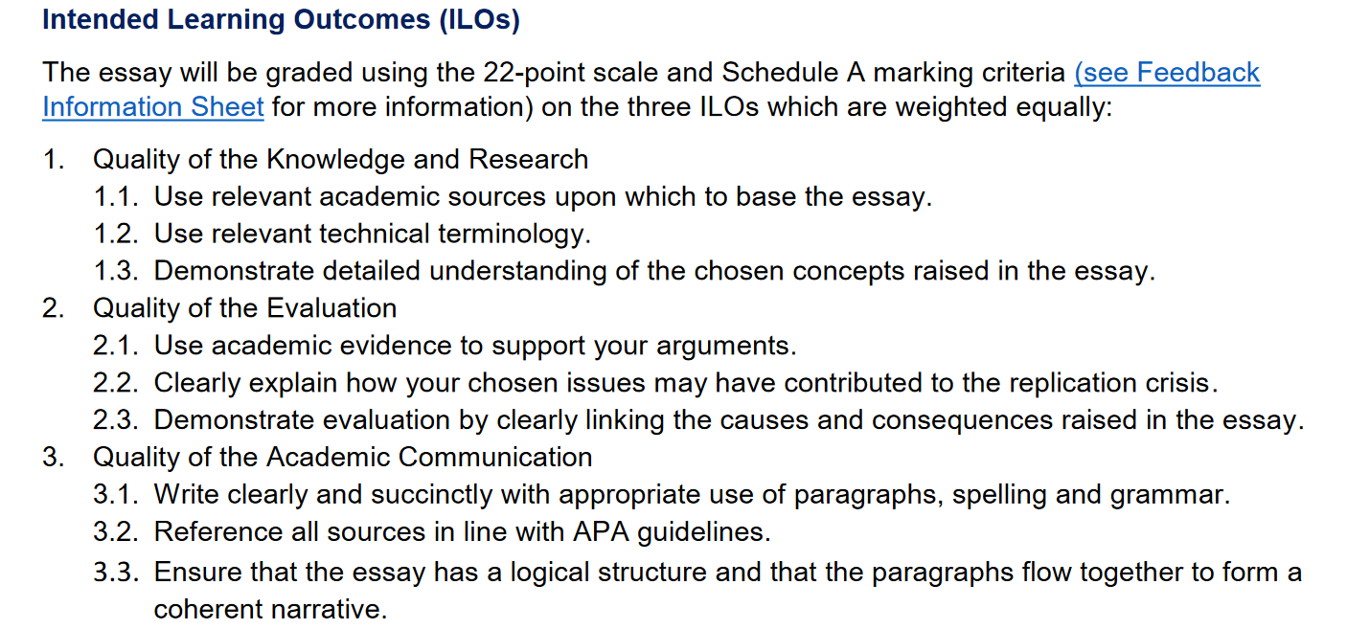
Assessment & feedback
Each course and assessment has Intended Learning Outcomes
Meet these outcomes = get a good grade
Check the Assessment Information Sheet and Feedback Information Sheet for each assignment
Lecture ILOs = exam questions
We are not trying to trick you
Review previous feedback before starting your next assignment

Slide 19

Help & support
Learning Enhancement & Academic Development Service (LEADS)
https://www.gla.ac.uk/myglasgow/leads/students/

Slide 20
Help & support
Counselling & Psychological Services
https://www.gla.ac.uk/myglasgow/counselling/
Disability Service
https://www.gla.ac.uk/myglasgow/disability/
If you have (or think you may have) additional needs such as dyslexia that give you provisions such as extra time, register with the disability service ASAP.
Advisor of Studies
Course Lead
Student/office/consultation hours
Ask questions about lecture content
Get additional support for assessments and/or interpreting and understanding feedback
If you want to talk to someone about any problems you might be facing
General chat/borrow a book/talk about Drag Race*
Check office hours here https://www.gla.ac.uk/schools/psychology/staff/
*certain staff only

Slide 21
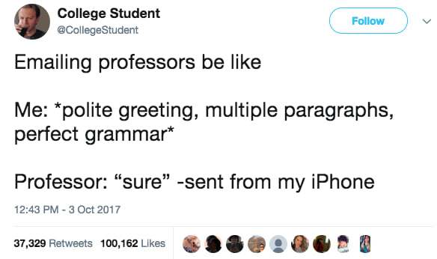
How to send an e-mail
Use your @glasgow.ac.uk account
Include your full name, GUID, and the specific course code
Make an effort to e-mail the right person and check that the answer to your question isn’t already available (e.g., in the course handbook)
Give us as much info as you can (e.g., if you’re having problems with Moodle tell us what solutions you’ve already tried)
Most of your lecturers will have an academic title, e.g., Dr. or Prof. Some may be ok with using their first name, some may wish you to be more formal – when in doubt go with Prof. (you’re unlikely to annoy someone with a promotion)
You may call me Emily or Dr. Nordmann. Please do not call me Mrs/Ms/Miss Nordmann.

Slide 22

Useful software and apps
OneDrive – don’t let the digital dog eat your homework, backup EVERYTHING
OneNote – organise and sync all your notes in one place
Office365 – In addition to OneDrive & OneNote you get access to all of Microsoft Office (Word, Excel, Powerpoint etc. for free)
ColdTurkey – Social media blocker
Outlook calendar (or any other calendar, just use a calendar)
Grammerly – spelling and grammar checking
GoConqr – create flashcards and quizzes for testing yourself
Other apps are available! You don’t need to use these exact ones but find something with similar functionality.

Slide 23

References
You don’t need to read all these – they’re here so that if you found something particularly interesting you can look up the original study (you’re going to learn how to search for journal articles in Lab 1).
Bos, N., Groeneveld, C., van Bruggen, J., & Brand-Gruwel, S. (2016) The use of recorded lectures in education and the impact on lecture attendance and exam performance. British Journal of Educational Technology, 47(5), 906–917 doi:10.1111/bjet.12300
Cepeda, N. J., Vul, E., Rohrer, D., Wixted, J. T., & Pashler, H. (2008). Spacing effects in learning a temporal ridgeline of optimal retention.Psychological science, 19(11), 1095-1102. http://files.eric.ed.gov/fulltext/ED505660.pdf
Dunlosky, J., Rawson, K. A., Marsh, E. J., Nathan, M. J., & Willingham, D. T. (2013). Improving students’ learning with effective learning techniques: Promising directions from cognitive and educational psychology. Psychological Science in the Public Interest, 14(1), 4-58.
Marsh, E. J., & Sink, H. E. (2010). Access to handouts of presentation slides during lecture: Consequences for learning. Applied Cognitive Psychology, 24(5), 691-706.
Mueller, P. A., & Oppenheimer, D. M. (2014). The pen is mightier than the keyboard: Advantages of longhand over laptop note taking. Psychological science, 25(6), 1159-1168.
Nordmann, E., Calder, C., Bishop, P., Irwin, A., & Comber, D. (2019). Turn up, tune in, don’t drop out: The relationship between lecture attendance, use of lecture recordings, and achievement at different levels of study. Higher Education, 77(6), 1065-1084.
Nordmann, E., Kuepper-Tetzel, C. E., Robson, L., Phillipson, S., Lipan, G., & Mcgeorge, P. (2018, December 11). Lecture capture: Practical recommendations for students and instructors. https://doi.org/10.31234/osf.io/sd7u4
Patterson, R. W., & Patterson, R. M. (2017). Computers and productivity: Evidence from laptop use in the college classroom. Economics of Education Review, 57, 66-79.
Putnam, A. L., Sungkhasettee, V. W., & Roediger III, H. L. (2016). Optimizing learning in college: tips from cognitive psychology. Perspectives on Psychological Science, 11(5), 652-660.
Sana, F., Weston, T., & Cepeda, N. J. (2013). Laptop multitasking hinders classroom learning for both users and nearby peers. Computers & Education, 62, 24-31.

